Slide 1
Class 1:
What is your job?
Business

Slide 2
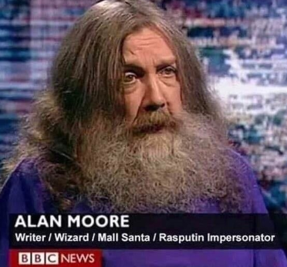
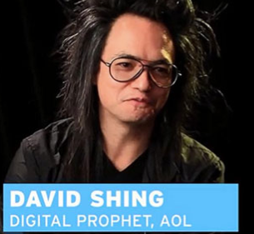
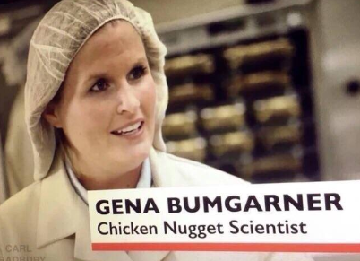
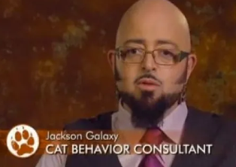
Warm Up
1) Read the memes and answer:
What is the funniest job title?
Source: https://justsomething.co/hilarious-job-titles/

Slide 3
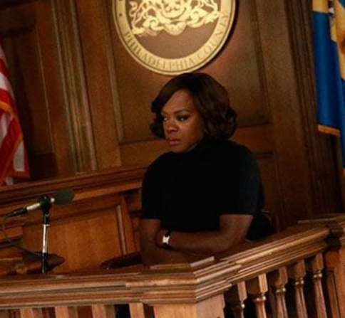
Vocabulary
1) Match jobs and pictures. Then listen and repeat the words.
lawyer
teacher
graphic designer
lawyer
chef
sales representative
teacher
graphic designer
pilot
sales representative
chef
pilot

Slide 4
1) Match jobs and pictures. Then listen and repeat the words.
marketing professional
doctor
IT specialist
doctor
nurse
IT specialist
engineer
nurse
journalist
engineer
marketing professional
journalist

Slide 5
2) Now, review the vocabulary by practicing these short dialogues:
A: What is your job?
B: I’m a
A: What do you do?
B: I’m an
A: What is your job?
B: I’m an
A: What do you do?
B: I’m a
IT specialist
doctor
chef
engineer

Slide 6
3) Listen and underline the stressed syllable.
a) Doctor
b) Specialist
c) Engineer
d) Manager
e) Teacher
f) Lawyer
g) Dentist

Slide 7
Listening
1) Listen to the street interview and order the job titles.
( ) Customer service at McDonald’s
( ) Crew member at Jersey Mike’s
( ) Sales representative
( ) Power systems automation engineer
( ) Cyber analyst
( ) Waiter at Cici’s Pizza
2
6
5
3
1
4

Slide 8
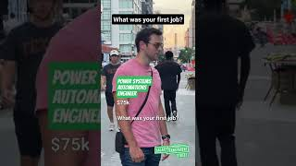
a) Customer service at McDonald’s
b) Crew member at Jersey Mike’s
c) Sales representative
d) Power systems automation engineer
e) Cyber analyst
f) Waiter at Cici’s Pizza
( c ) ( d ) ( e 75-80k
( f ) $7.25
( b ) minimum wage
( a ) $8.25
https://www.youtube.com/shorts/yovMEwLXRAs
2) Now, watch and check your answers.
3) Match the salary with the job title.
c
d
e
f
b
a

Slide 9
4) Some people receive per hour worked. Tick the job titles that receive per hour.
( x ) Customer service at McDonald’s
( x ) Crew member at Jersey Mike’s
( Sales representative
( Power systems automation engineer
( Cyber analyst
( x Waiter at Cici’s Pizza
x
x

Slide 10
Grammar - Indefinite Articles
1) Look at these questions:
A: What is your job?
B: I’m an engineer.
A: What do you do?
B: I’m a chef.
They both are indefinite articles and mean 1. What is the difference?

Slide 11
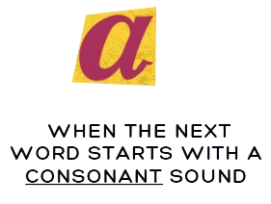
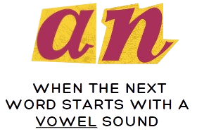
2) Read the rules:
3) Now, put the correct indefinite article for the job titles.
______ doctor _____ engineer
______ nurse _____ IT specialist
_____ teacher ______ influencer
______ lawyer _____ artist
journalist account manager
a
an
a
an
a
an
a
an
a
an

Slide 12
Grammar - Verb Be: I and You
1) Look at these pronouns and the pictures.
I
You

Slide 13
2) Read the rules:
Positive | Short form | Negative | Short form
I am a teacher. | I’m a teacher. | I am not a student. | I’m not a student.
You are a manager. | You’re a manager. | You are not an engineer. | You aren’t an engineer.

Slide 14
3) Practice writing the correct pronoun (I, you) or verb be (am, are).
a) _______ am your supervisor.
b) _______ are my boss.
c) I _______ an IT specialist.
d) You _______n’t working at McDonald’s.
e) I _______ not a pilot.
f) You _______ a great chef!
I
You
am
are
am
are

Slide 15
Talking and Practicing
1) What is your job now?
2) What is your dream job?
3) What was your first job?

Slide 16
4) Play tic tac toe.
To mark you must say the
job title in a complete sentence.
Example: You are a doctor.
I am a journalist.

Slide 18
Congratulations!

Slide 19
Feedback
Date:

Slide 20
Vocabulary

Slide 21
Grammar

Slide 22
Pronunciation

Slide 23
What went well
Even better if

